Slide 1
Healthcare TRAINcation
Eastern Workforce
Fort Morgan June 3-6
Josh Gibbs
Limon June 10-13
Melody Bolton

Slide 2


Slide 3
TRAINcation Beginnings
Model of TRAINcation
  Successful program 3 years running (6 camps total, 3 Workforce Centers)
  In partnership with NECOM – Manufacturing Sector Partnership
  Focused on Soft Skills and Industry Tours

Slide 6
Here and Now 2019 – Healthcare TRAINcation
2 Workforce Centers
  Fort Morgan – 18 students
  Limon – 13 students
Expose and Prepare
Business/Employer Relationships

Slide 7
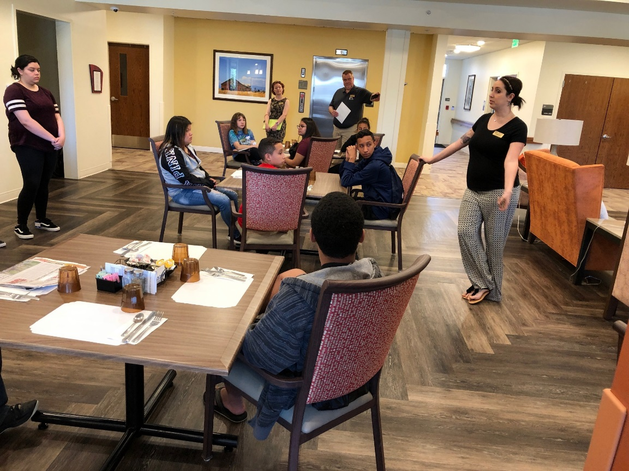
Fort Morgan
East Morgan County Hospital
  Clinic Tour
  Rehab
  OR
  ER/Ambulance/Medi-Evac
  Radiology Lab
Eben Ezer Care Center
  Day trip to Elder care center
  Recent and Current Construction

Slide 8
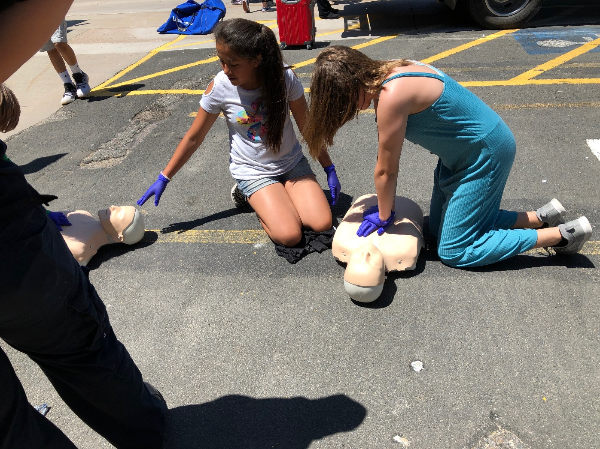
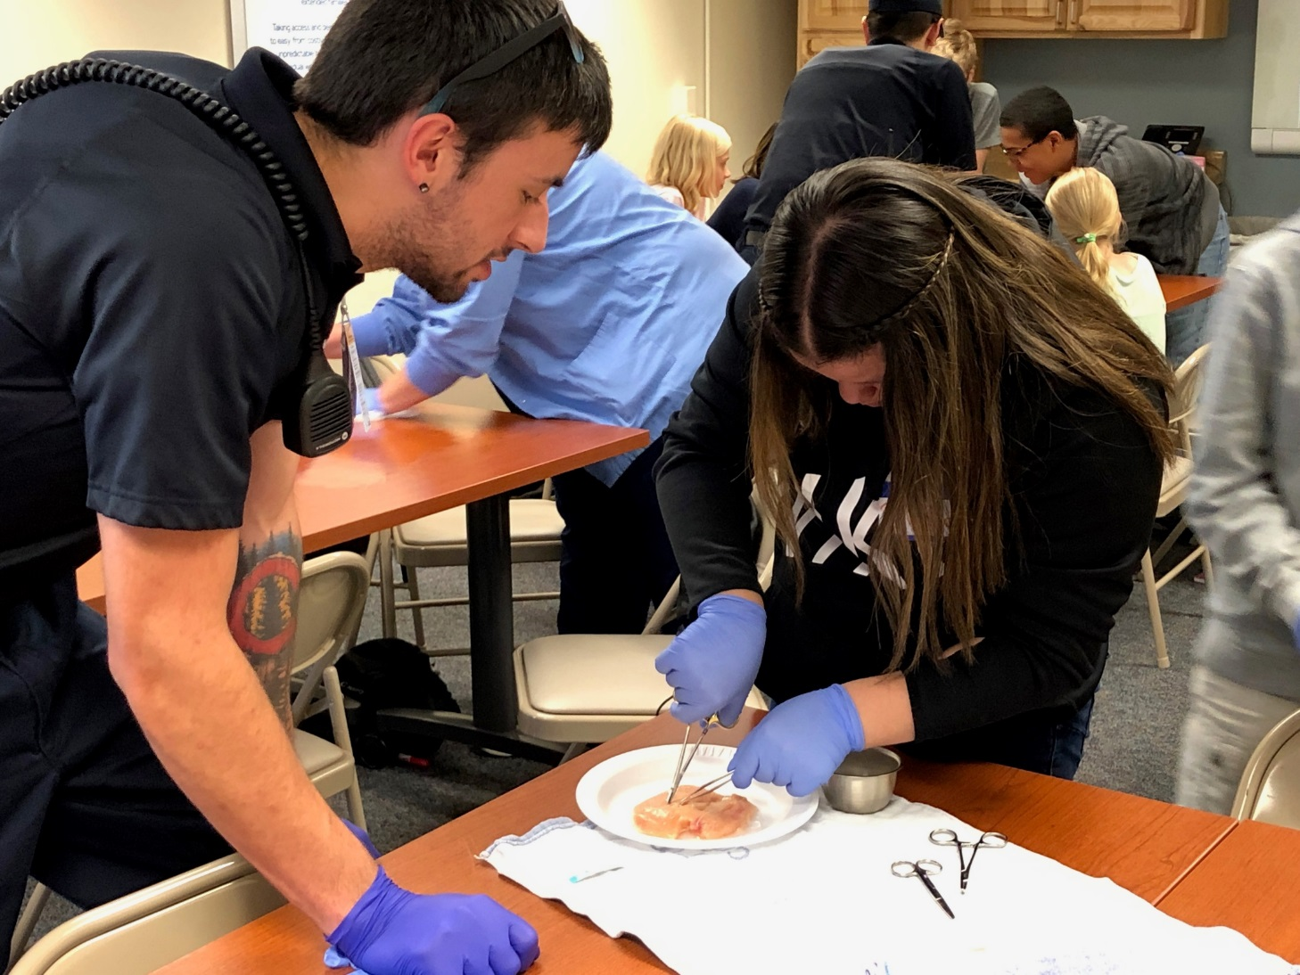
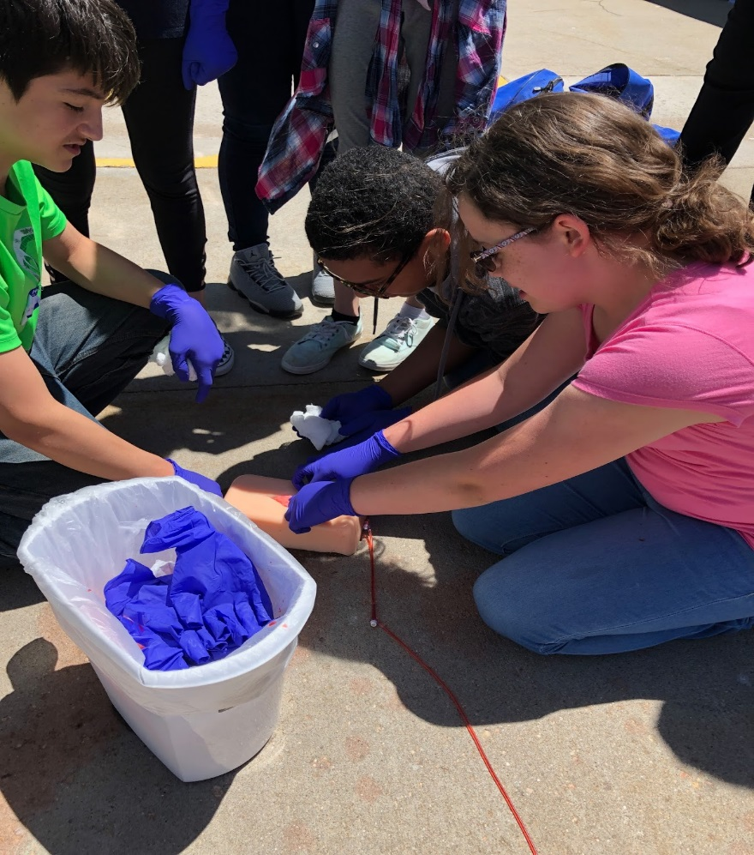
Fort Morgan

Slide 9
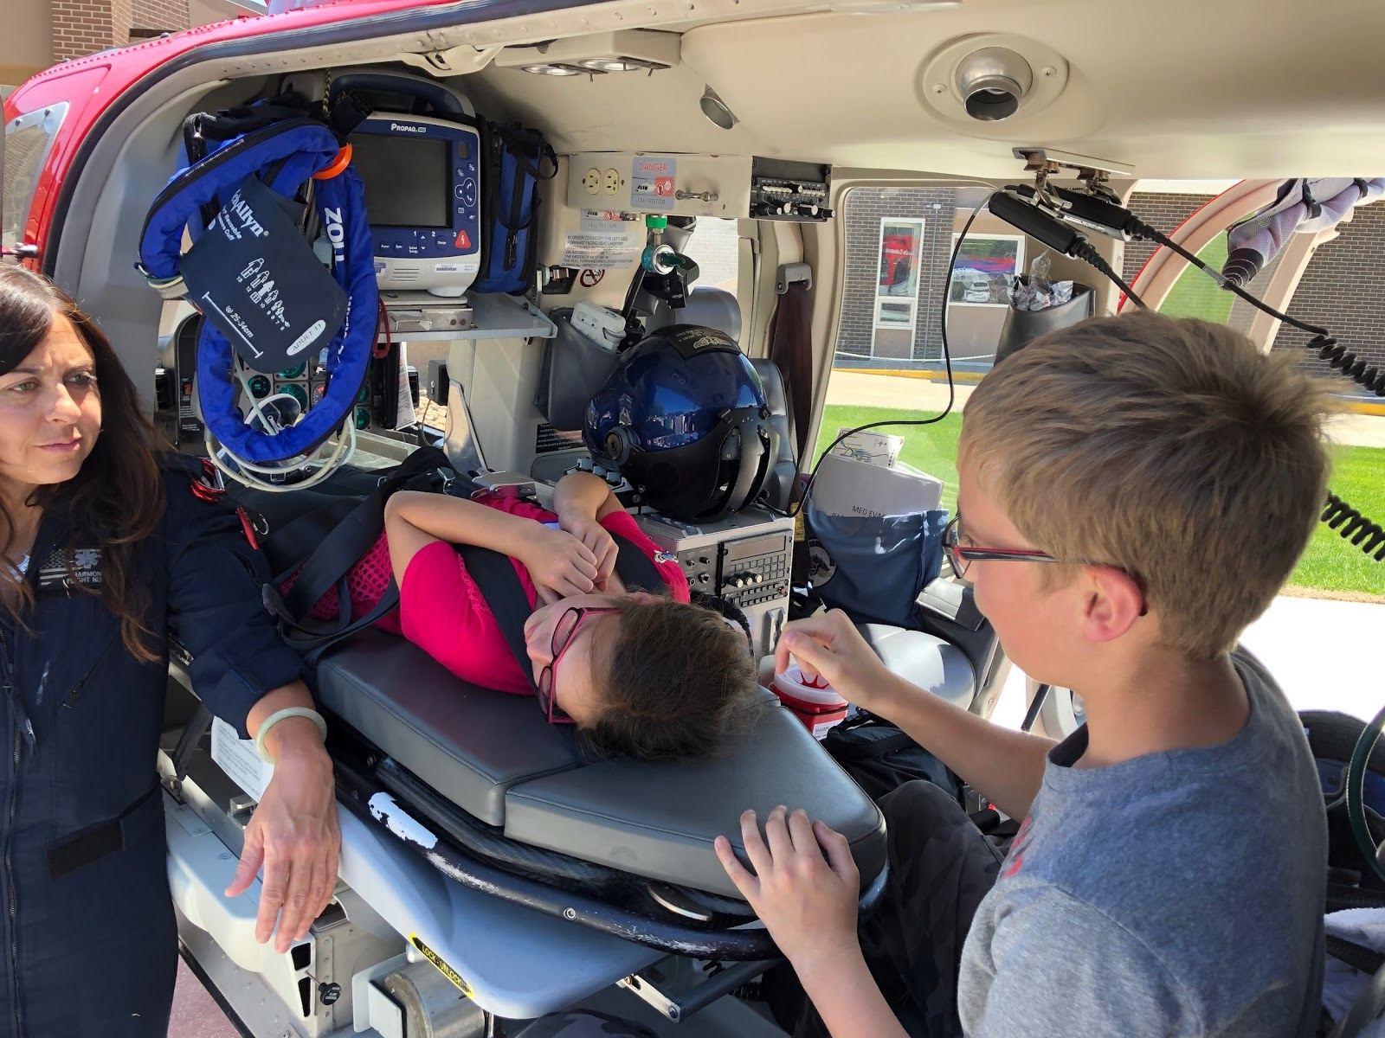
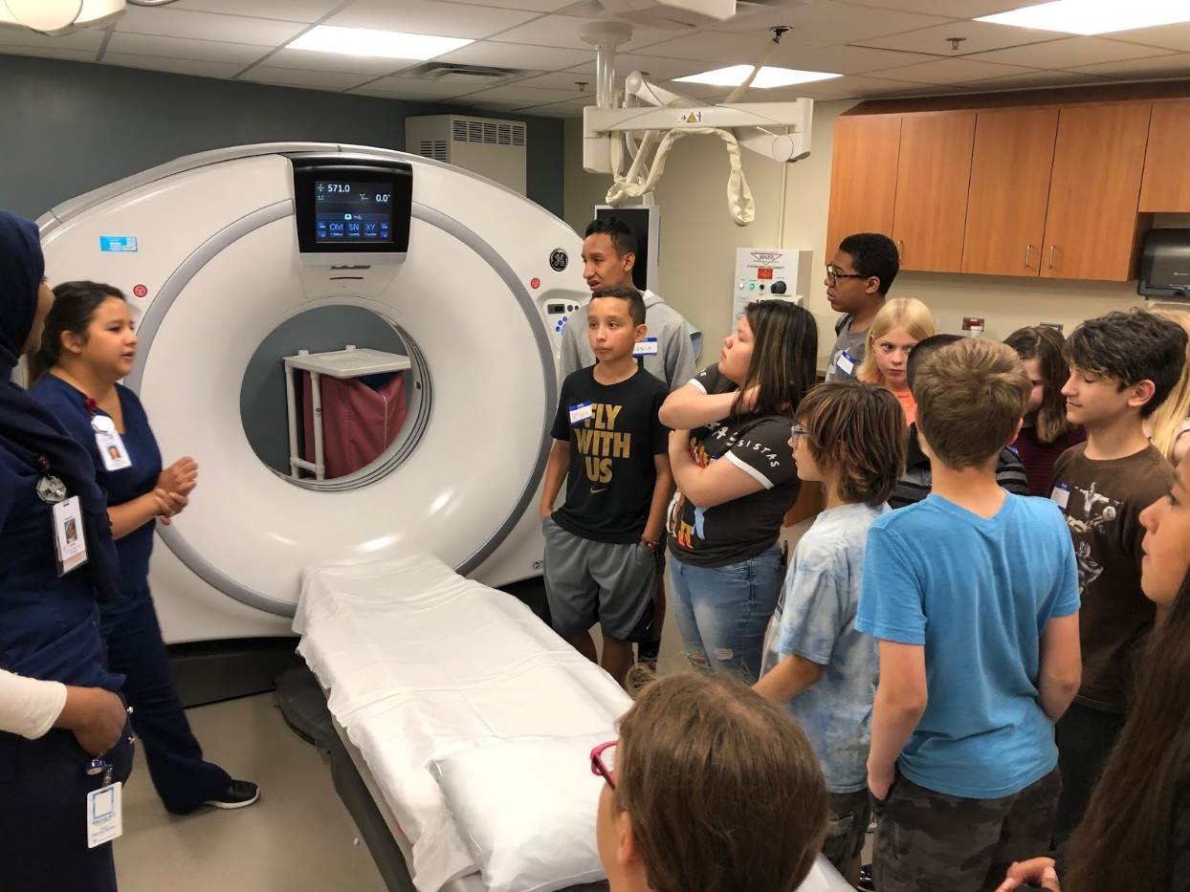

Slide 10
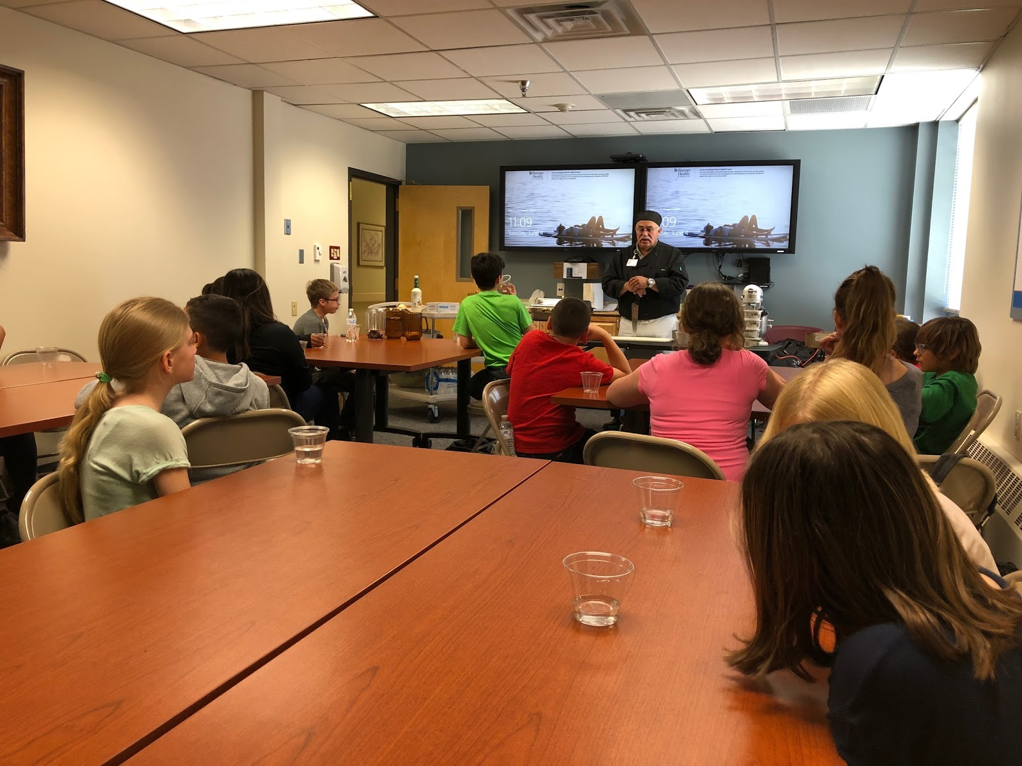
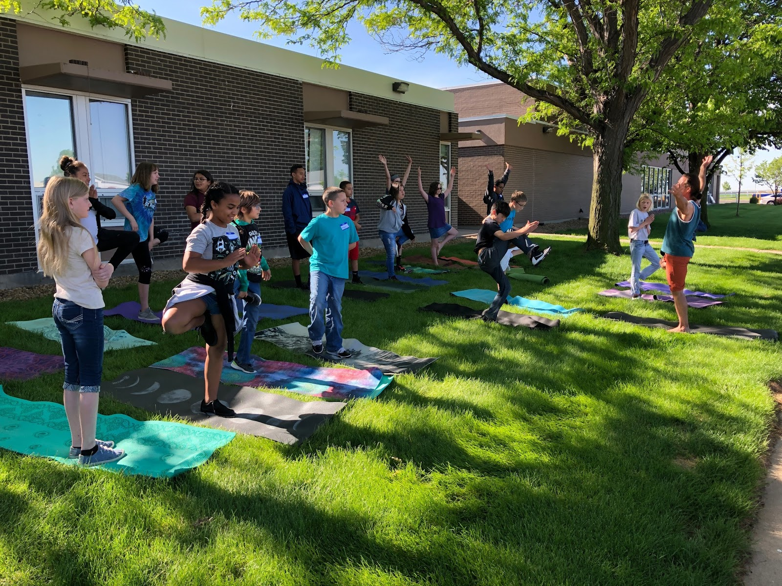
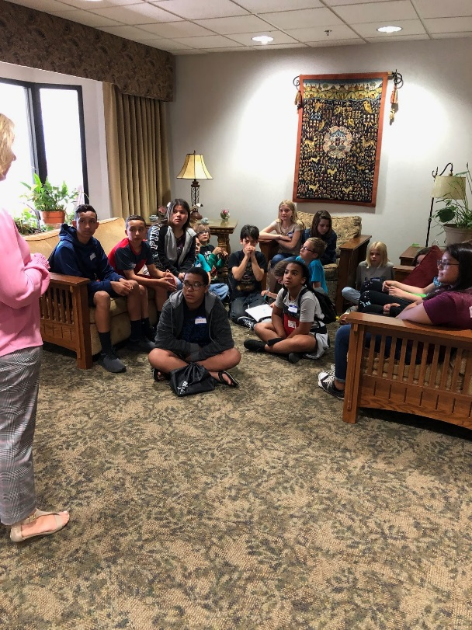
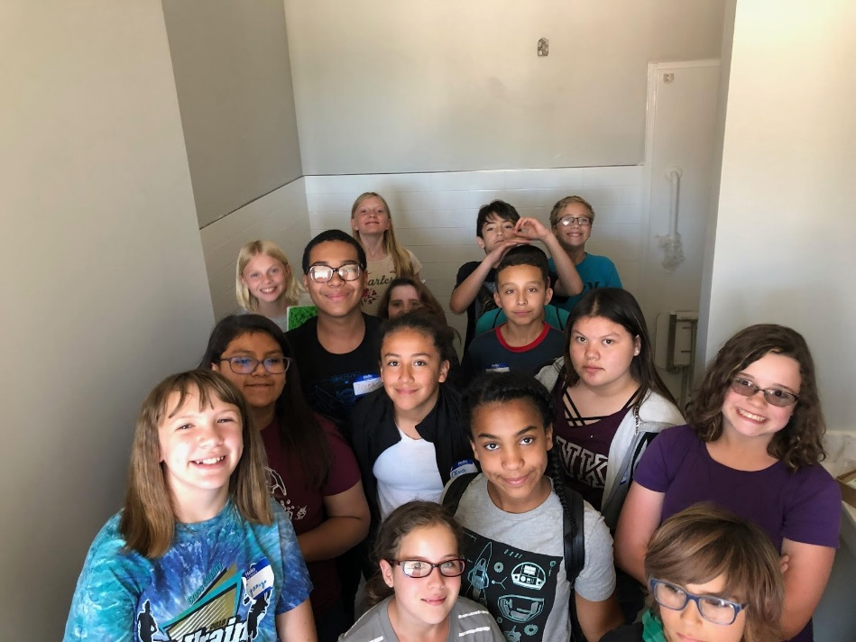

Slide 11
Limon
Held at Limon Community Center
Speakers:
  Eastern Vet Services
  Morgan Community College
  Centennial Mental Health
  American Heart Association – Basic Life Support Training
Tours
  Lincoln Community Hospital and Care Center
  Hoffman Drug Store
  Peak Vista Community Health

Slide 12
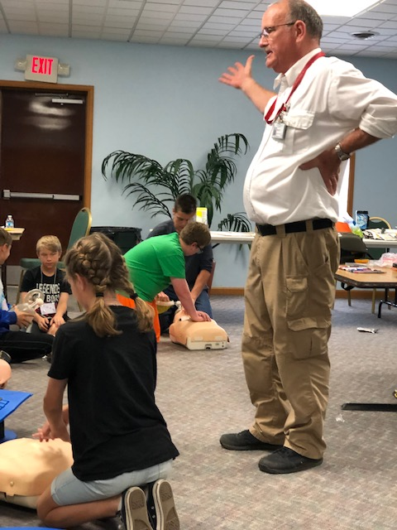
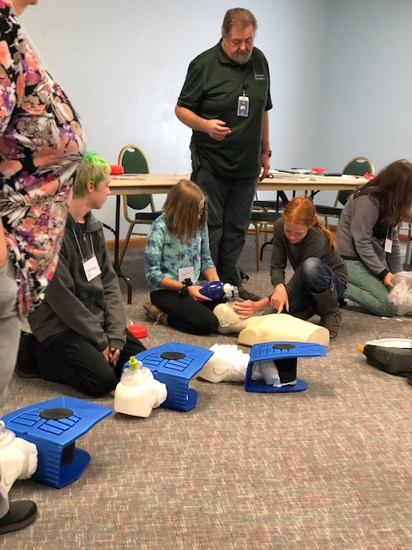
Limon

Slide 13
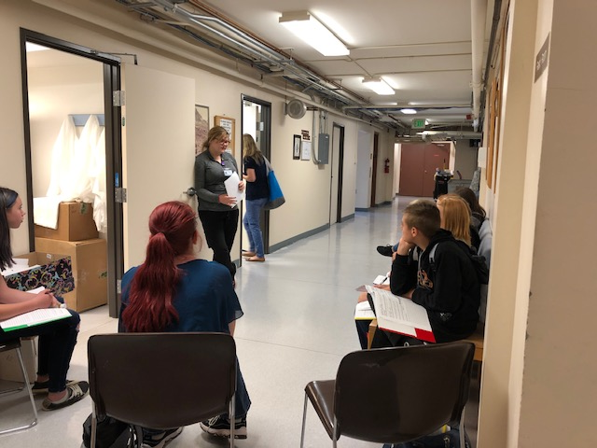
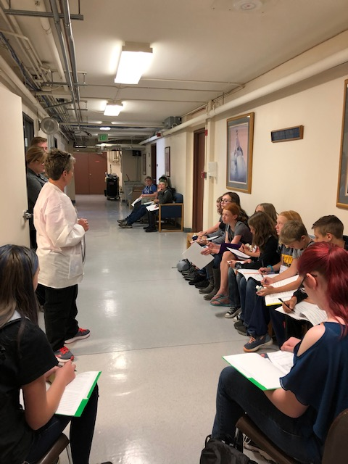

Slide 14
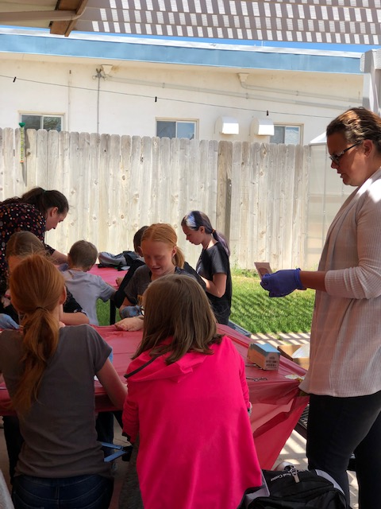
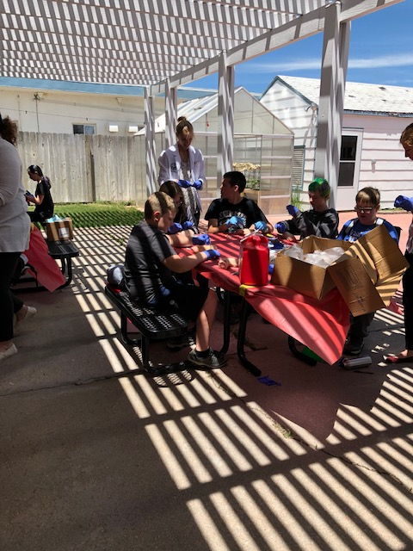
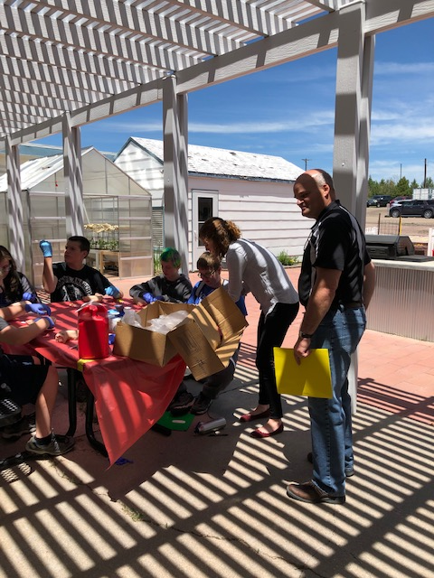

Slide 15
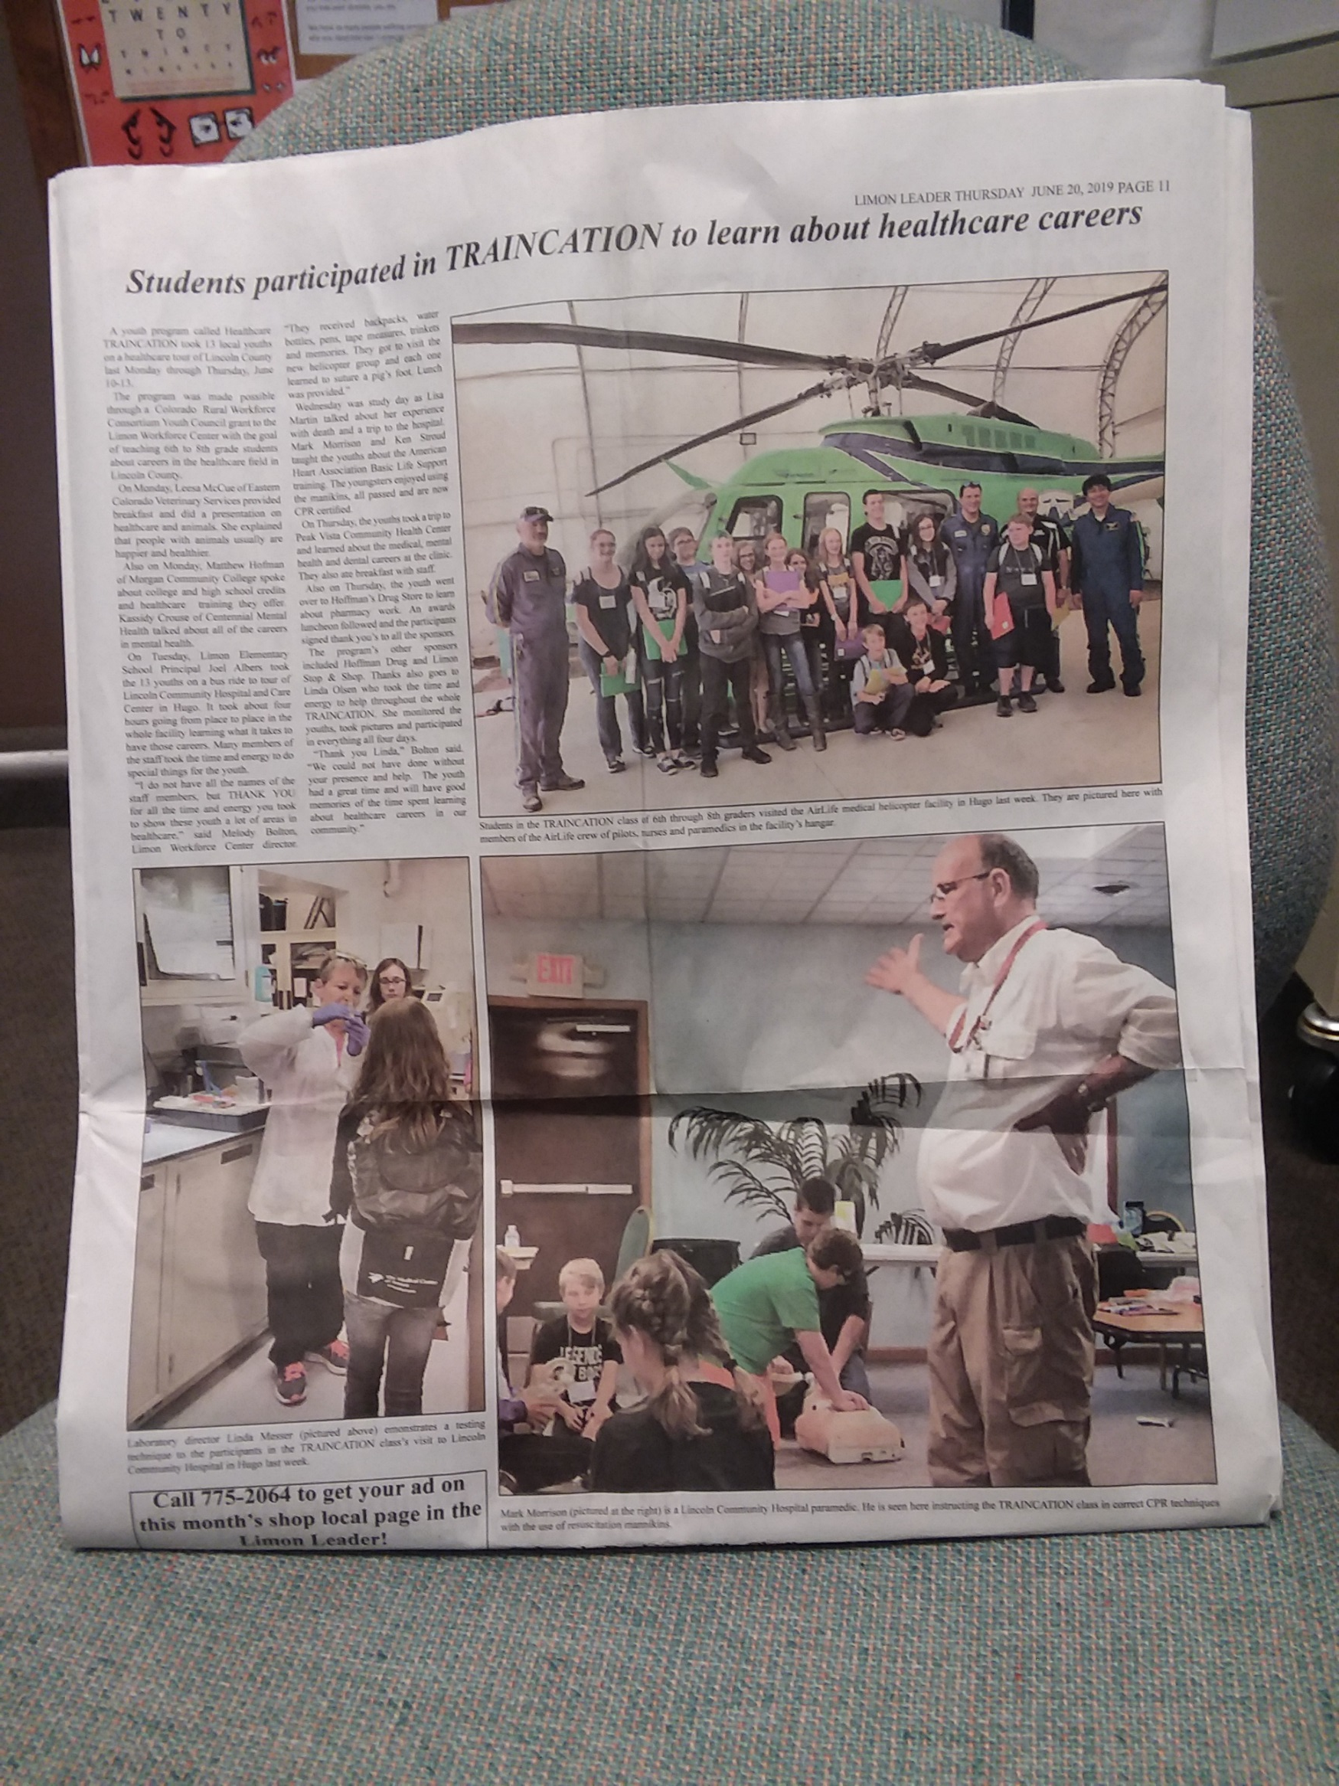

Slide 16
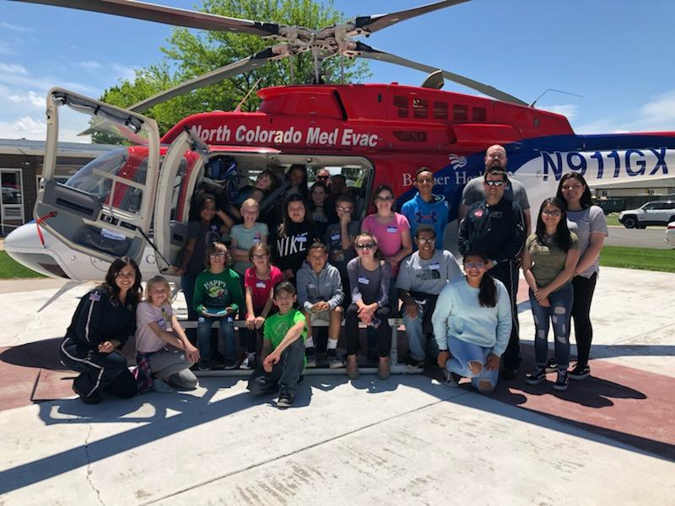
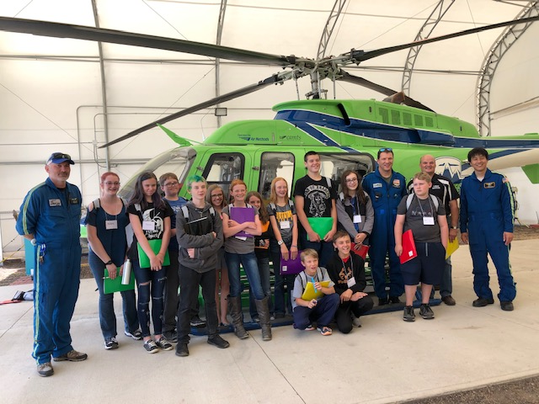
Thank You!

