Slide 1
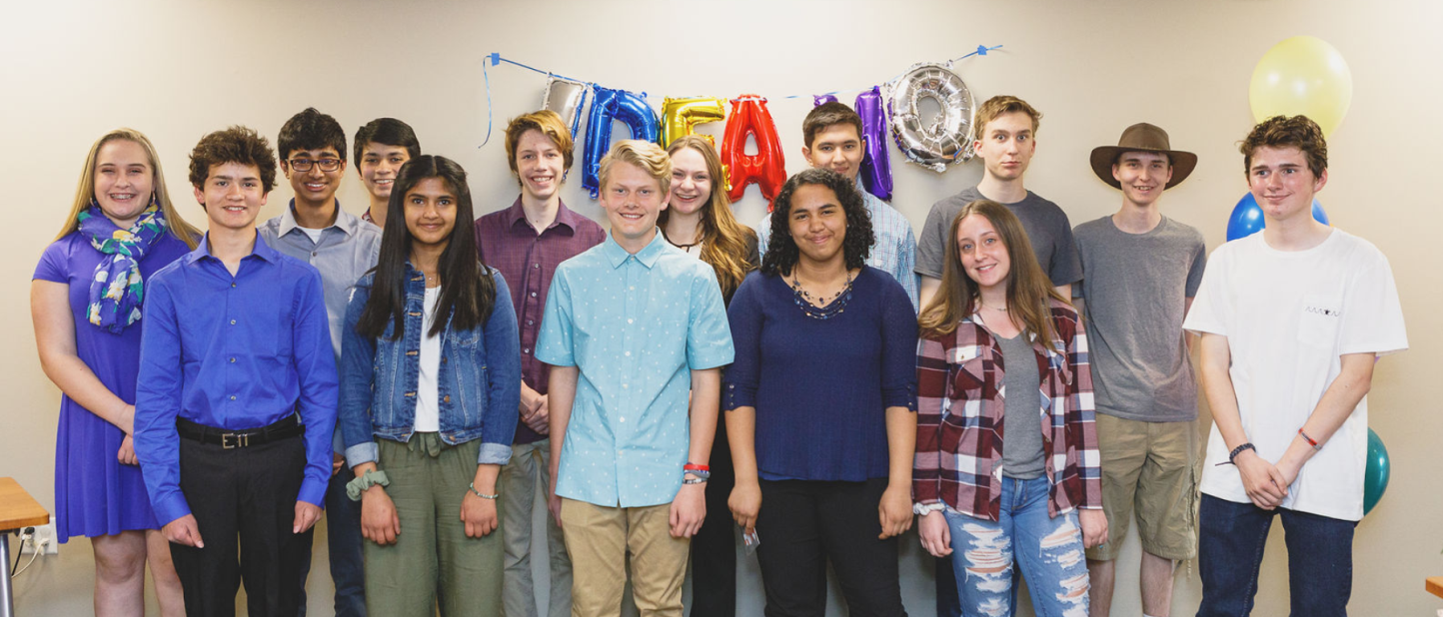
Kristen Erby
Young Adult Employment Specialist
City and County of Broomfield
Workforce Center

Slide 2
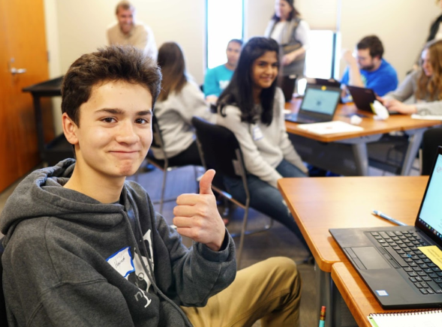
The Broomfield Workforce Center partnered with the Broomfield Library Makerspace, and the Small Business Development Center to provide an eight week after-school entrepreneurship program for teens – IdeaHQ. The program culminated in a presentation challenge similar to that on the popular TV program, Shark Tank.

Slide 3
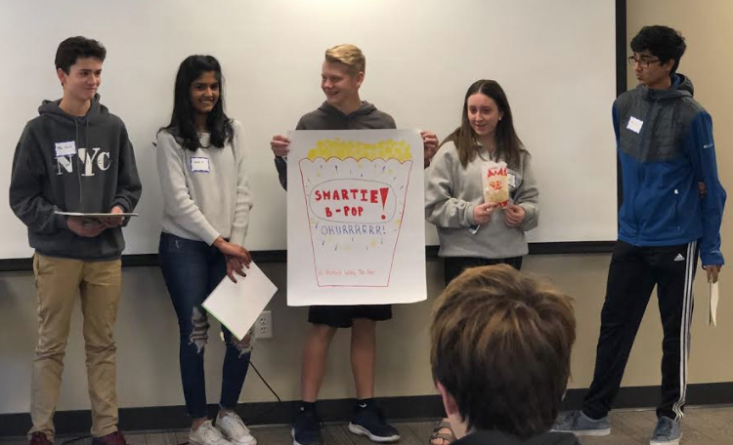
Program goals included:
Increase leadership skills
Teach employment soft skills
Connect youth with Colorado Career Pathways
Teach Entrepreneurial and small business ownership skills
Increase self-confidence of participants

Slide 4
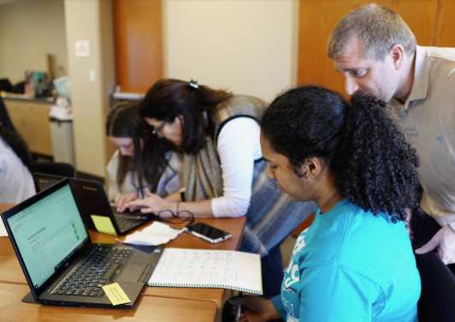
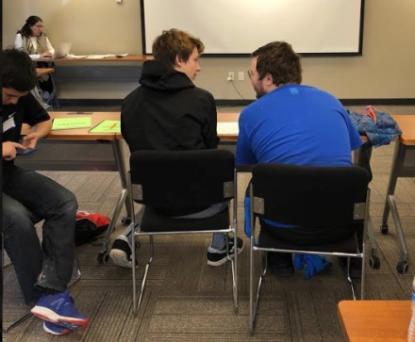
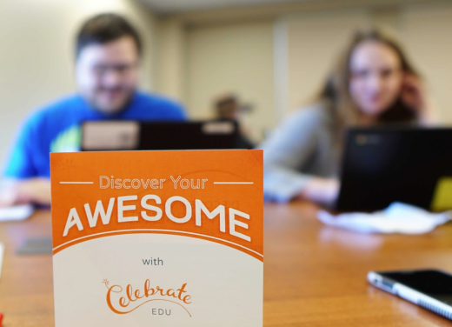
The participants attended a weekly series of fun and collaborative workshops to determine a product or business idea they would like to develop.

Slide 5
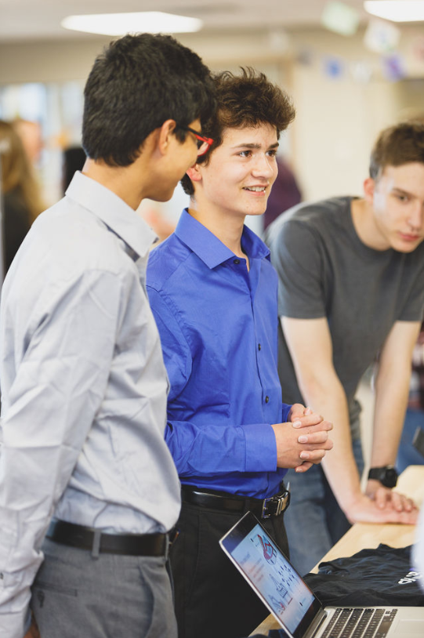
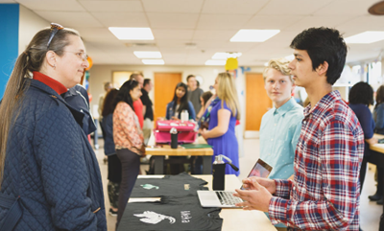
After a full day of an idea generation workshop, the teens were invited to work with InventHQ to bring their product or business idea from concept to market.
Various Broomfield business leaders attended the weekly sessions to share their stories, inspire and encourage, and answer questions.

Slide 6
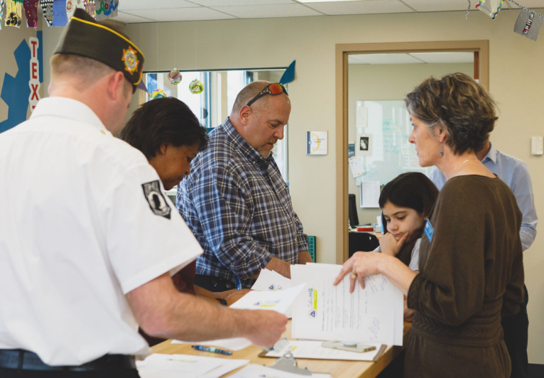
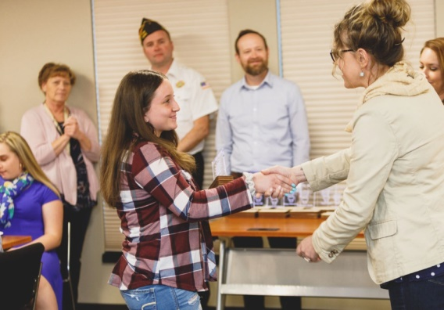
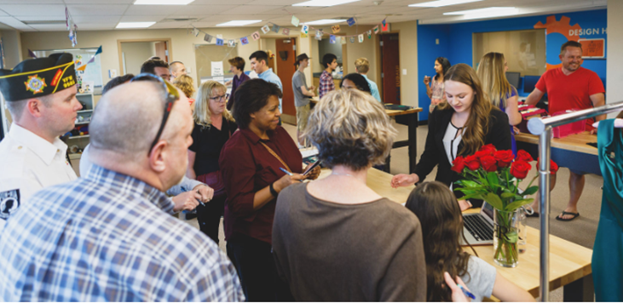
The judges included a member of the Broomfield City Council, senior staff of the Broomfield Health and Human Services Division, and a member of the local VFW leadership.

Slide 7
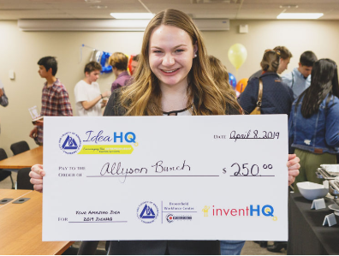
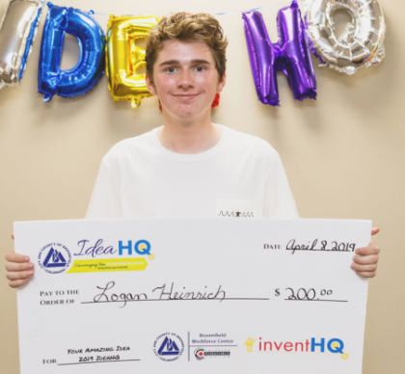
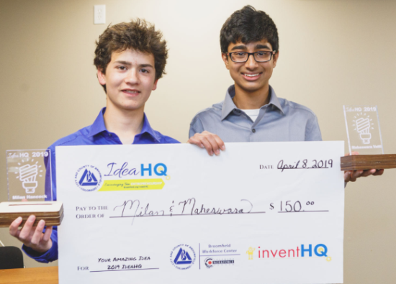
After much deliberation by the judges, the top three business concepts were selected and awarded monetary prizes as seed money for their business start-up.

Slide 8
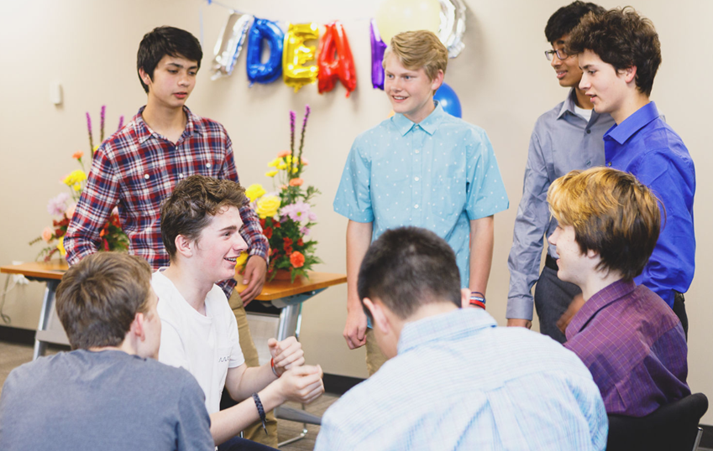
IdeaHQ fostered many partnerships to ensure a successful and meaningful experience for the participants. The City and County of Broomfield Workforce Center partnered with:
InventHQ
Celebrate EDU
The Broomfield Chamber of Commerce
The North Metro Small Business Development Center
Local High Schools, Broomfield HHS and Foster Care Program staff, FISH Food Bank, A Precious Child, Mental Health Partners
Broomfield VFW Post 9565
Morgridge Family Foundation
RTD – Broomfield Call-A-Ride

Slide 9
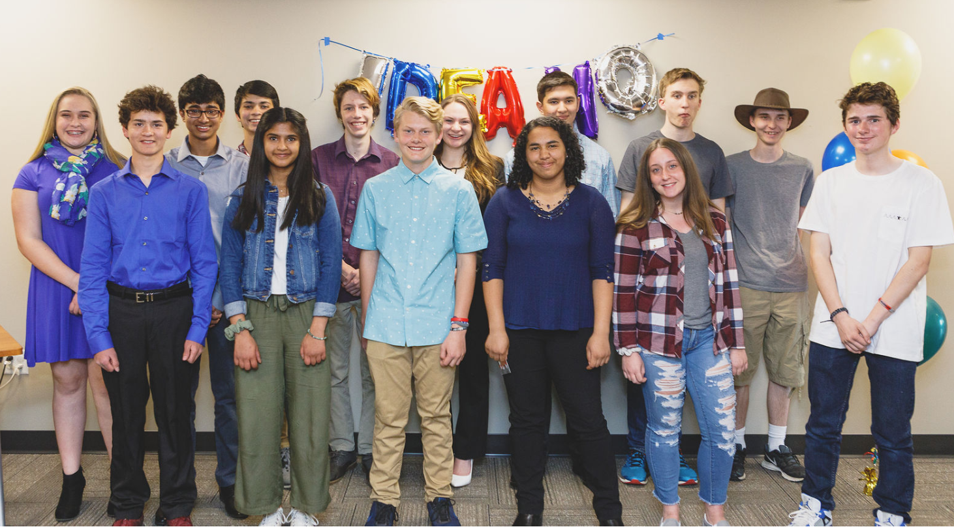
Thank you for your support and funding of IdeaHQ. This outstanding program strengthened our community partnerships, and provided an entrepreneurial experience for Broomfield teens. We look forward to providing this experience again in the future.

